Slide 1
SLACK v1

Slide 2
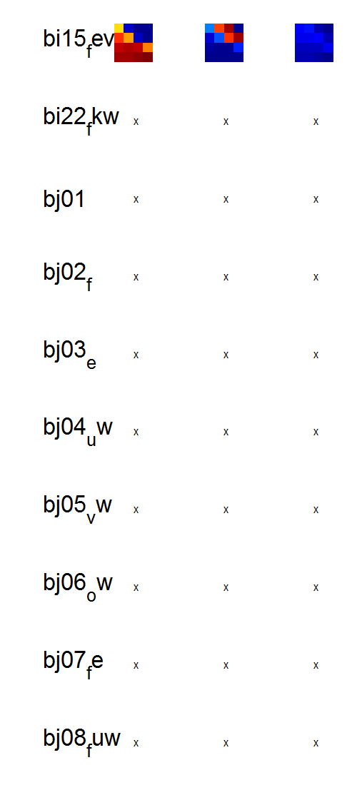
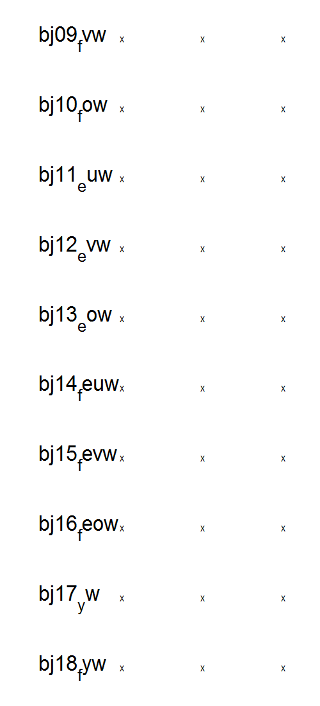
\
D:\Dropbox\SANDISK\8 Explore Mem\3b Modelling\1 Inputs\2b Hierar fits\New\res_hierarfitmodels_cF (16-Apr-2015) v1 remaining BICredone
Transform = 0

Slide 3
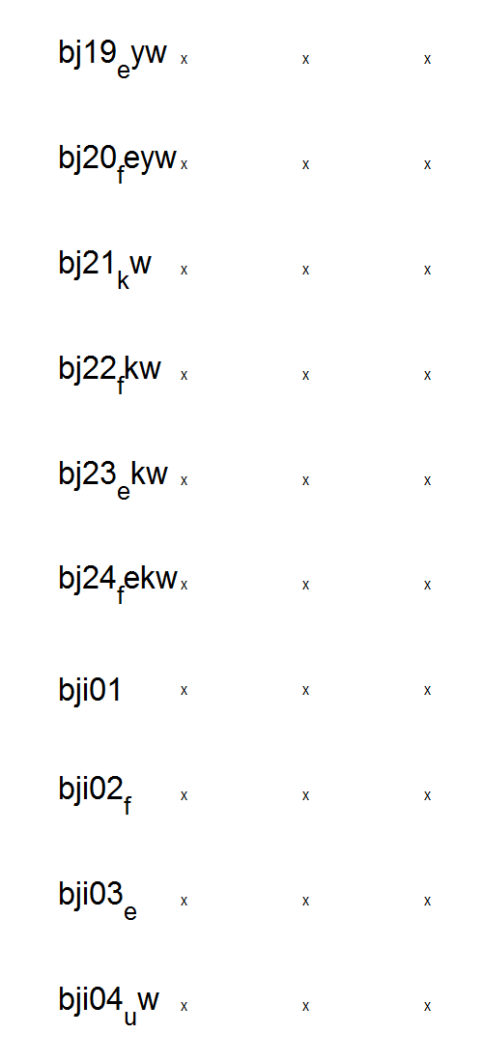
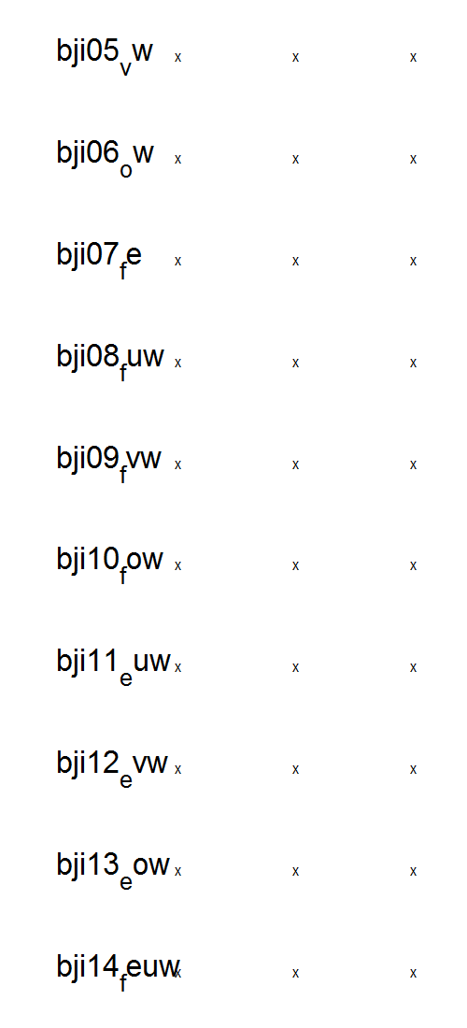
\
D:\Dropbox\SANDISK\8 Explore Mem\3b Modelling\1 Inputs\2b Hierar fits\New\res_hierarfitmodels_cF (16-Apr-2015) v1 remaining BICredone
Transform = 0

Slide 4
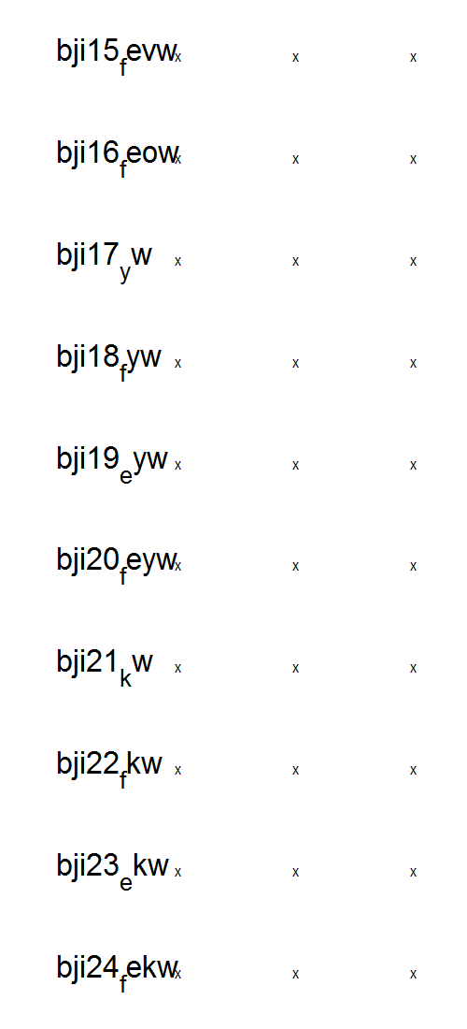
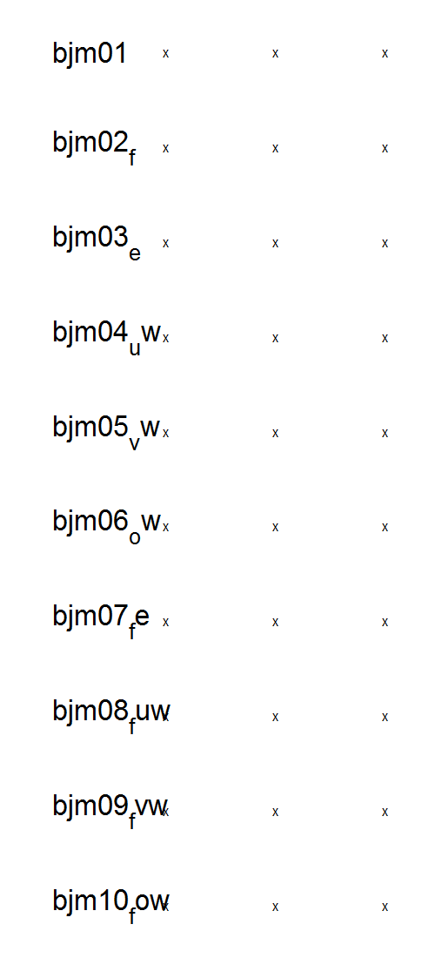
\
D:\Dropbox\SANDISK\8 Explore Mem\3b Modelling\1 Inputs\2b Hierar fits\New\res_hierarfitmodels_cF (16-Apr-2015) v1 remaining BICredone
Transform = 0

Slide 5
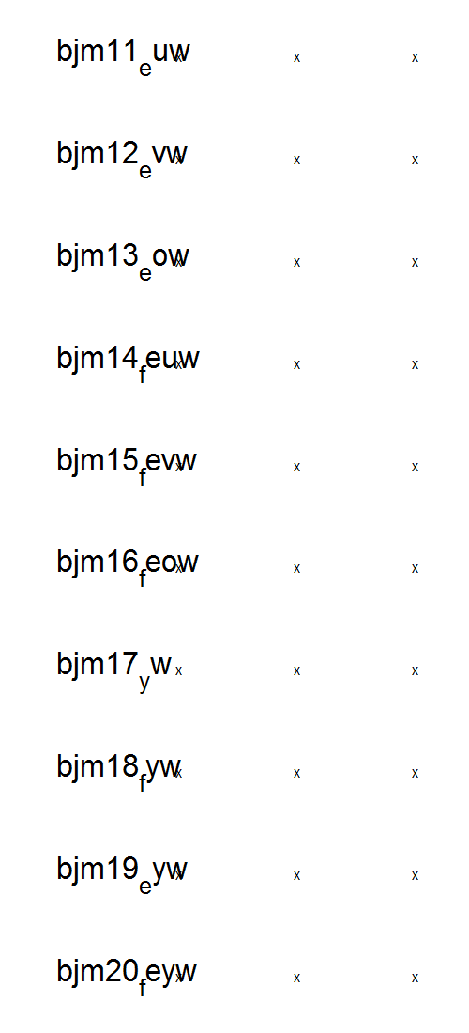
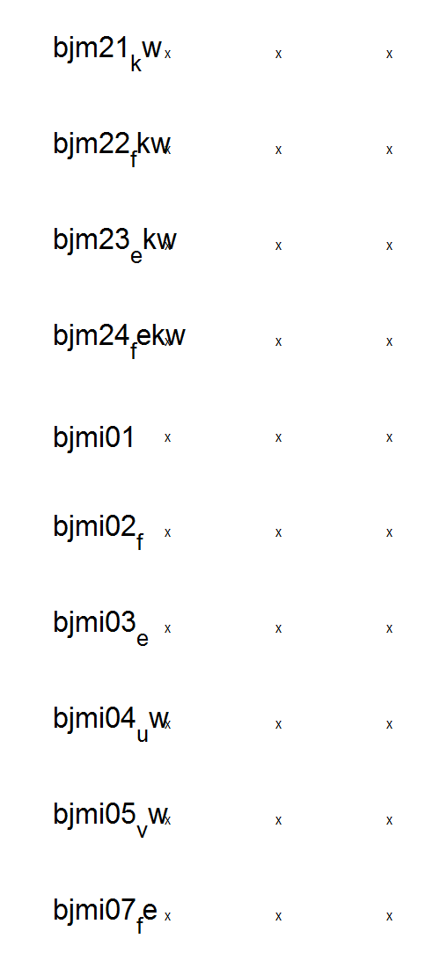
\
D:\Dropbox\SANDISK\8 Explore Mem\3b Modelling\1 Inputs\2b Hierar fits\New\res_hierarfitmodels_cF (16-Apr-2015) v1 remaining BICredone
Transform = 0

Slide 6
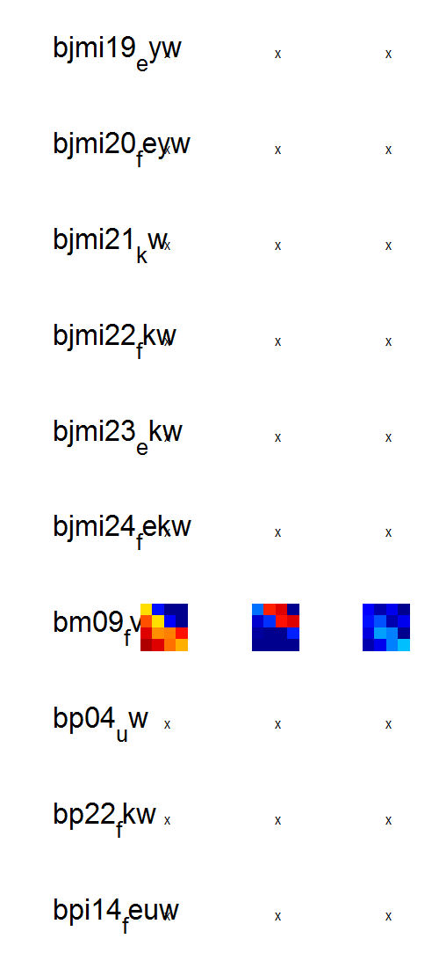
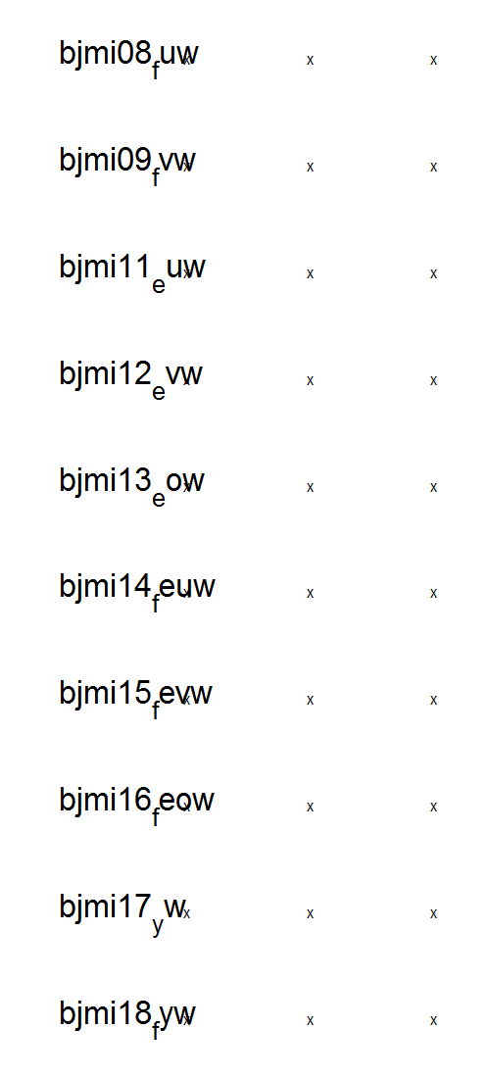
\
D:\Dropbox\SANDISK\8 Explore Mem\3b Modelling\1 Inputs\2b Hierar fits\New\res_hierarfitmodels_cF (16-Apr-2015) v1 remaining BICredone
Transform = 0

Slide 7
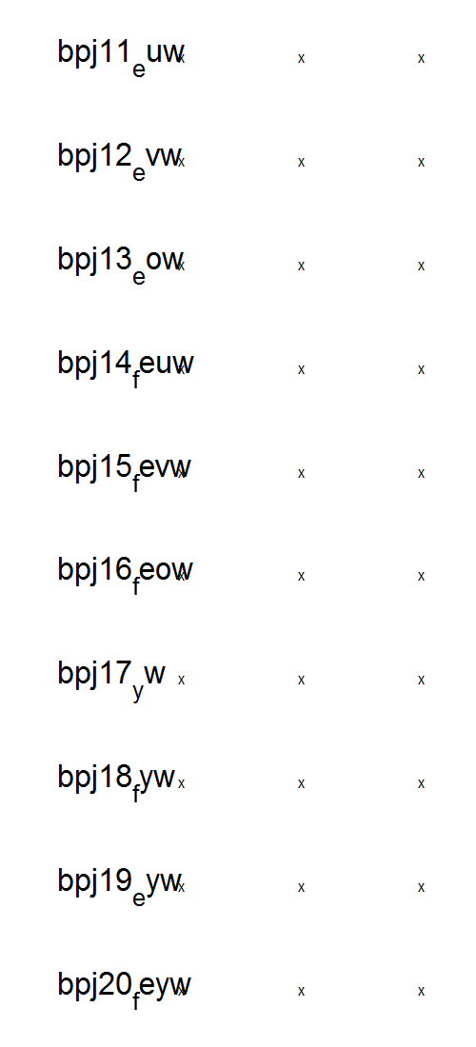
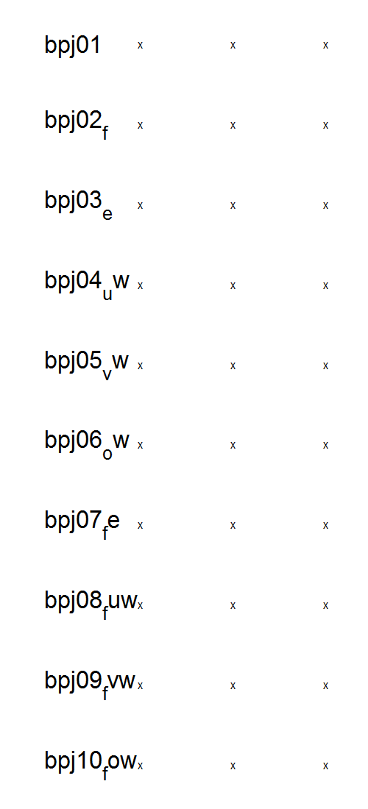
\
D:\Dropbox\SANDISK\8 Explore Mem\3b Modelling\1 Inputs\2b Hierar fits\New\res_hierarfitmodels_cF (16-Apr-2015) v1 remaining BICredone
Transform = 0

Slide 8
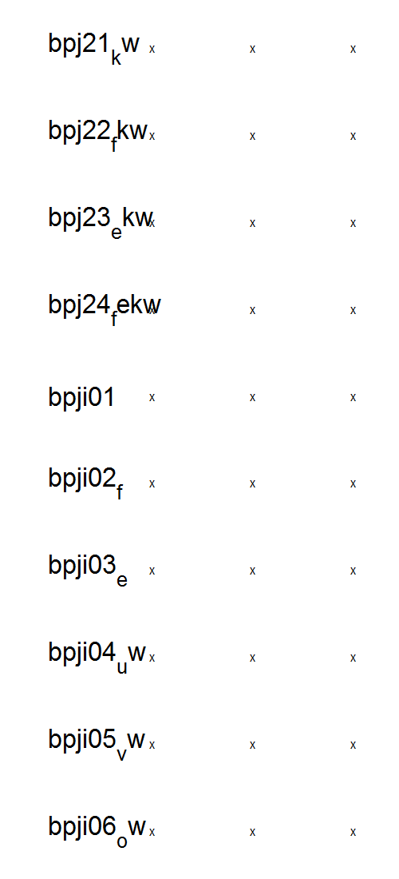
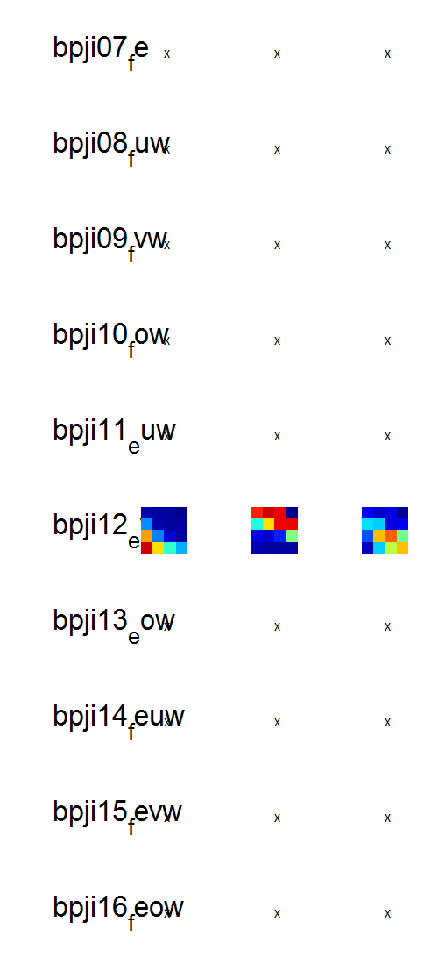
\
D:\Dropbox\SANDISK\8 Explore Mem\3b Modelling\1 Inputs\2b Hierar fits\New\res_hierarfitmodels_cF (16-Apr-2015) v1 remaining BICredone
Transform = 0

Slide 9
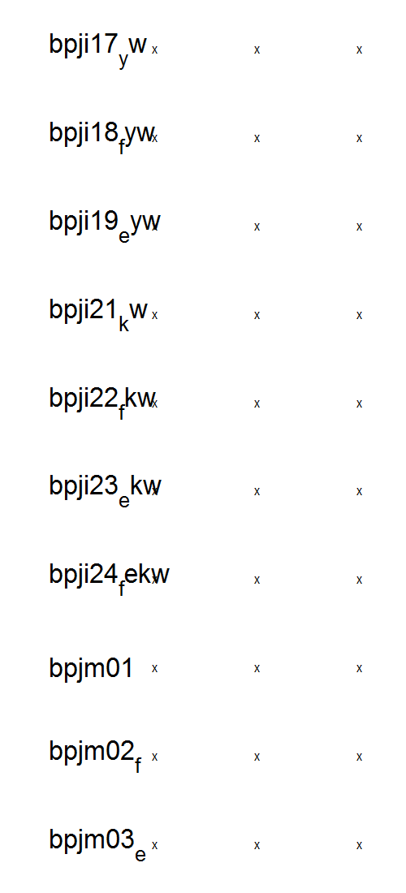
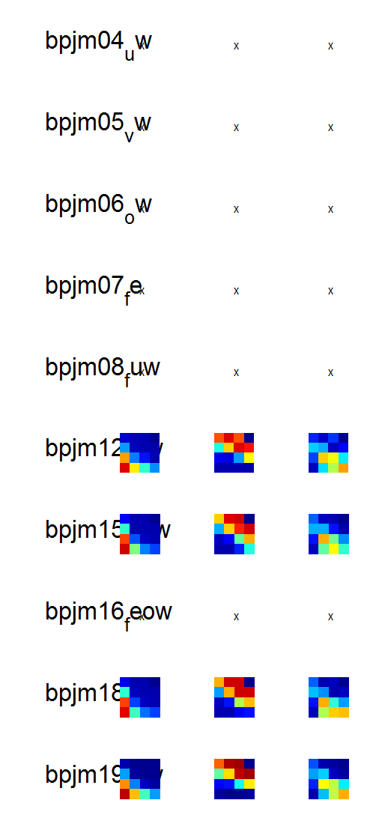
\
D:\Dropbox\SANDISK\8 Explore Mem\3b Modelling\1 Inputs\2b Hierar fits\New\res_hierarfitmodels_cF (16-Apr-2015) v1 remaining BICredone
Transform = 0

Slide 10
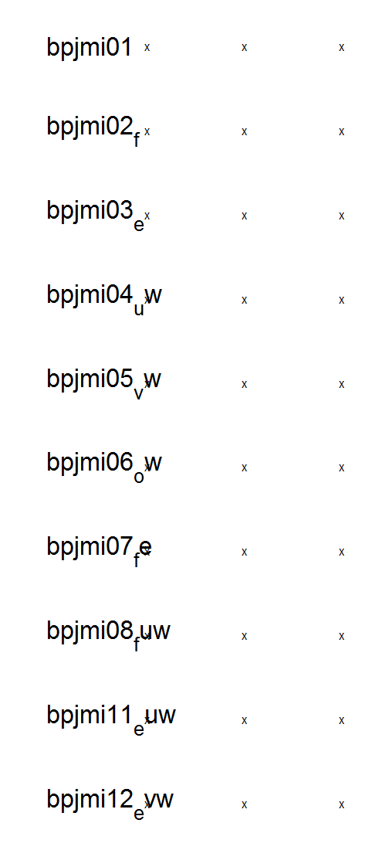
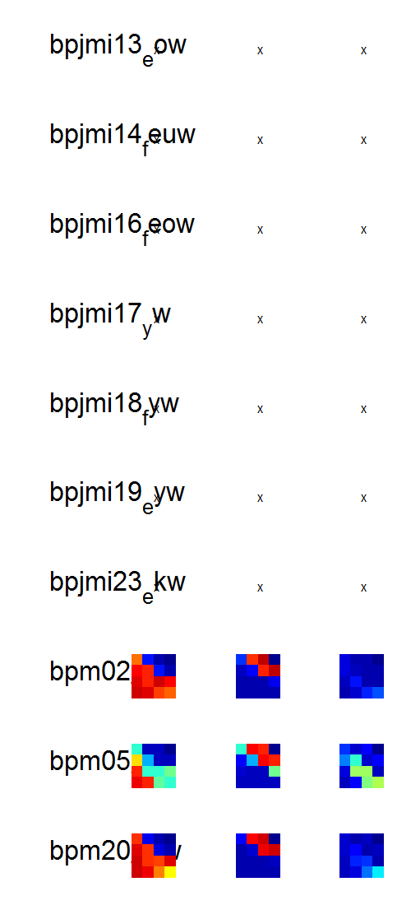
\
D:\Dropbox\SANDISK\8 Explore Mem\3b Modelling\1 Inputs\2b Hierar fits\New\res_hierarfitmodels_cF (16-Apr-2015) v1 remaining BICredone
Transform = 0

Slide 11
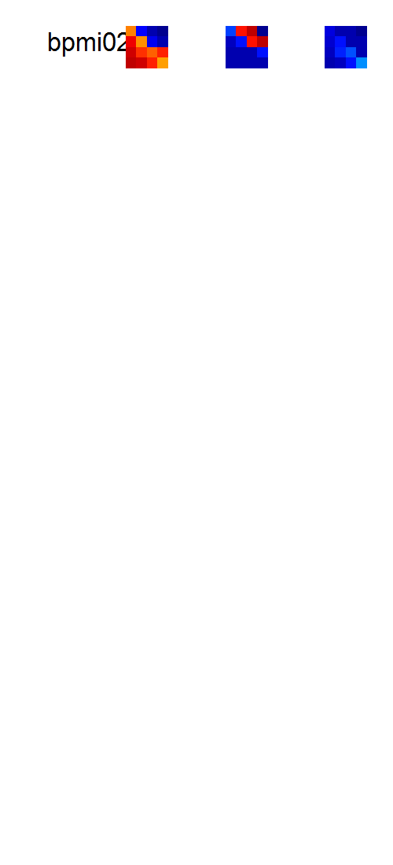
\
D:\Dropbox\SANDISK\8 Explore Mem\3b Modelling\1 Inputs\2b Hierar fits\New\res_hierarfitmodels_cF (16-Apr-2015) v1 remaining BICredone
Transform = 0

Slide 12
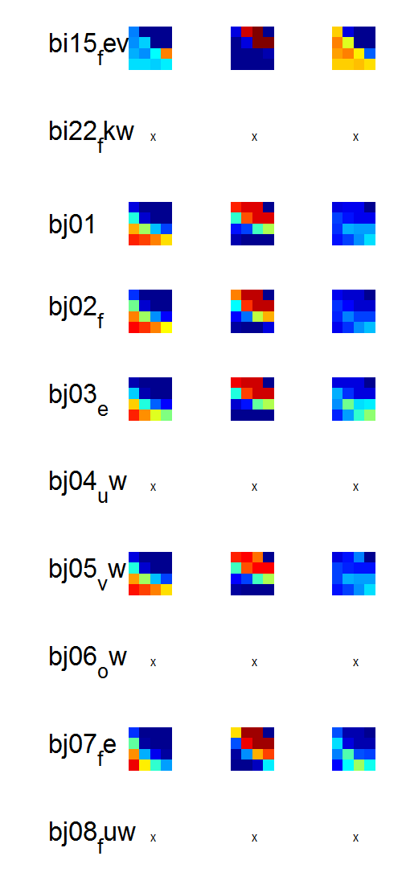
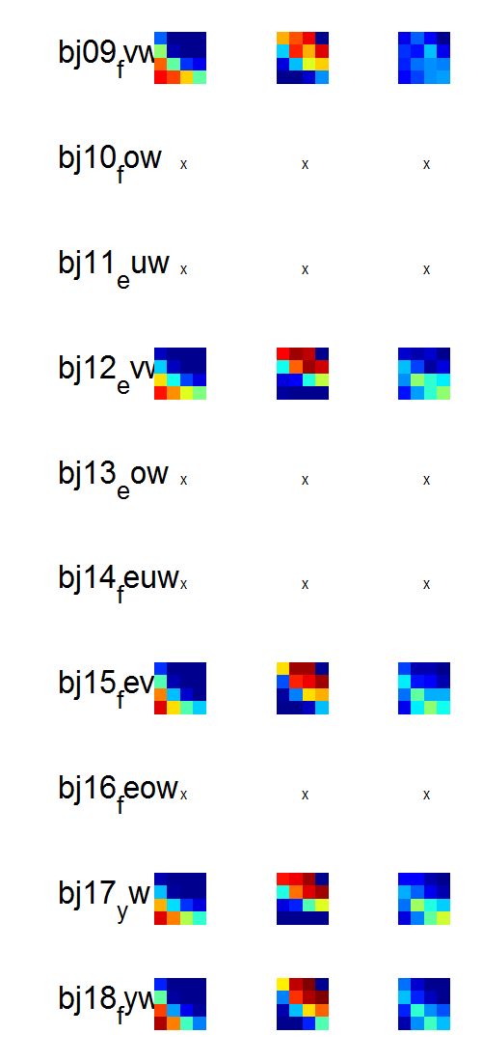
D:\Dropbox\SANDISK\8 Explore Mem\3b Modelling\1 Inputs\2b Hierar fits\New\res_hierarfitmodels_cF (16-Apr-2015) v1 remaining BICredone
Transform = +1;

Slide 13
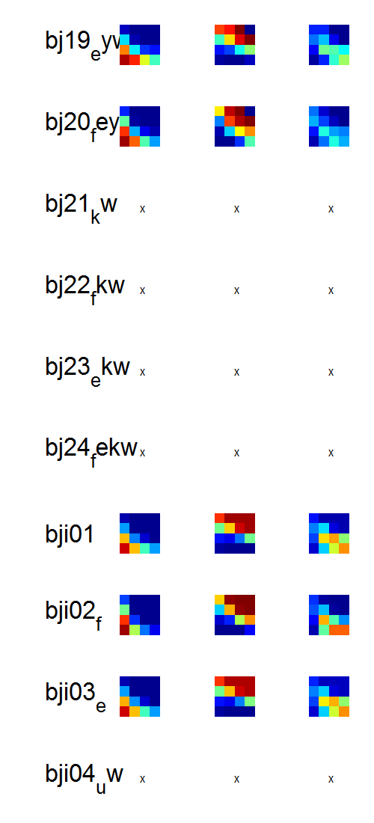
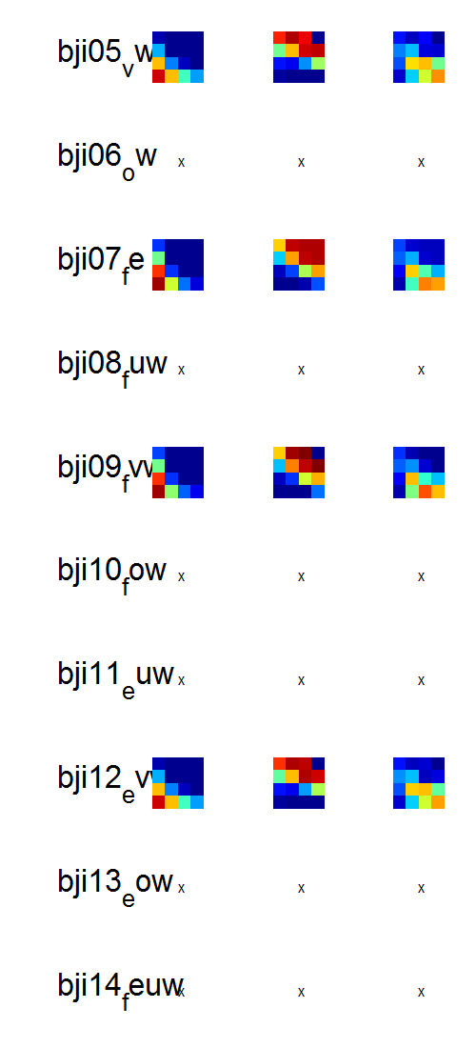
D:\Dropbox\SANDISK\8 Explore Mem\3b Modelling\1 Inputs\2b Hierar fits\New\res_hierarfitmodels_cF (16-Apr-2015) v1 remaining BICredone
Transform = +1;

Slide 14
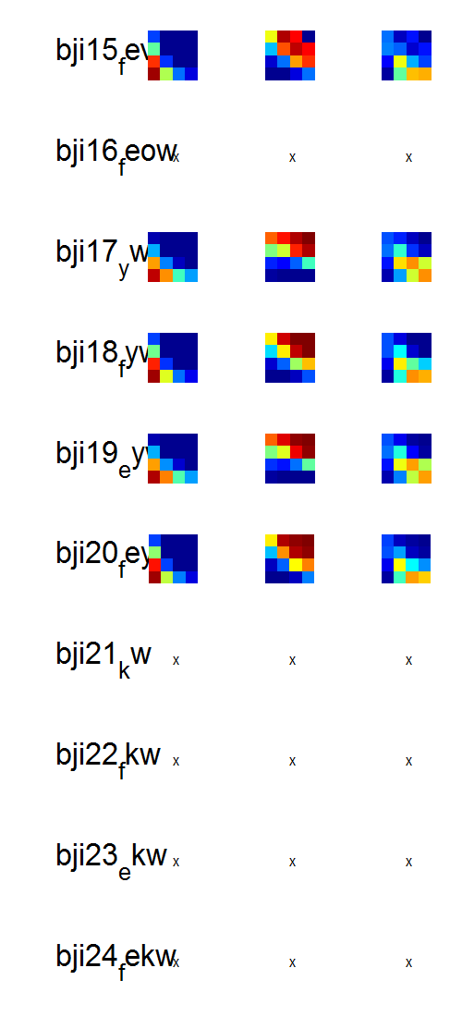
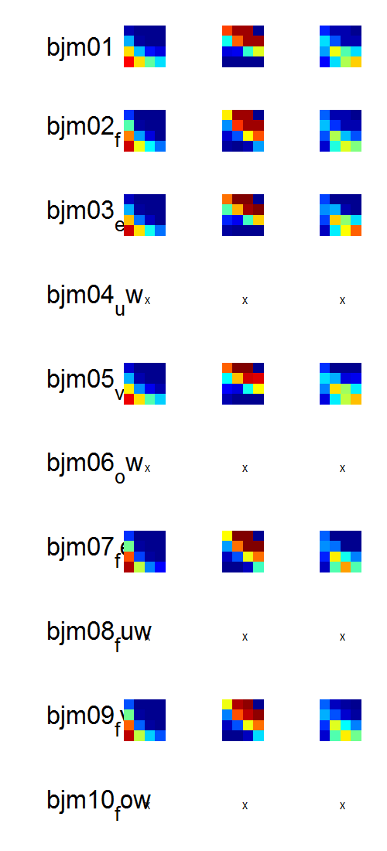
D:\Dropbox\SANDISK\8 Explore Mem\3b Modelling\1 Inputs\2b Hierar fits\New\res_hierarfitmodels_cF (16-Apr-2015) v1 remaining BICredone
Transform = +1;

Slide 15
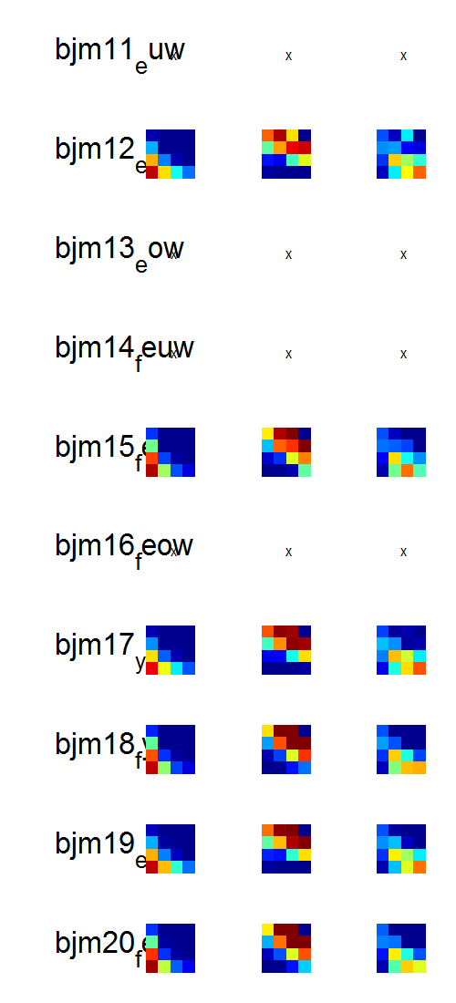
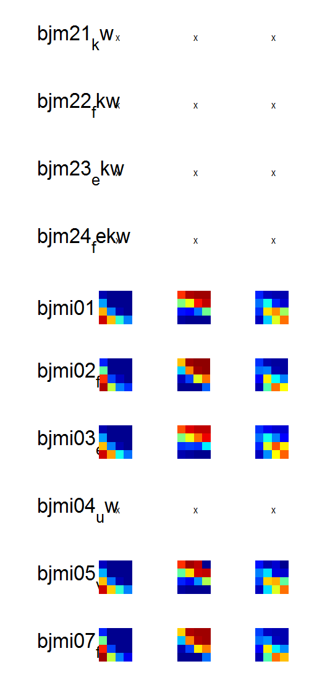
D:\Dropbox\SANDISK\8 Explore Mem\3b Modelling\1 Inputs\2b Hierar fits\New\res_hierarfitmodels_cF (16-Apr-2015) v1 remaining BICredone
Transform = +1;

Slide 16
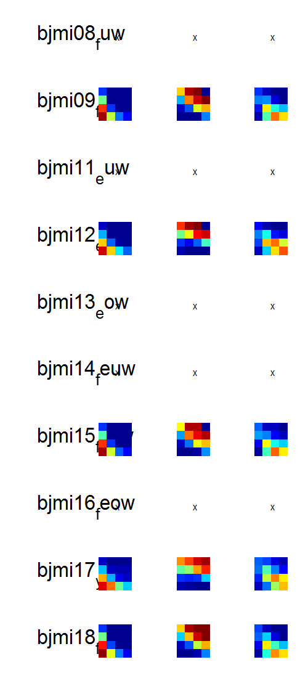
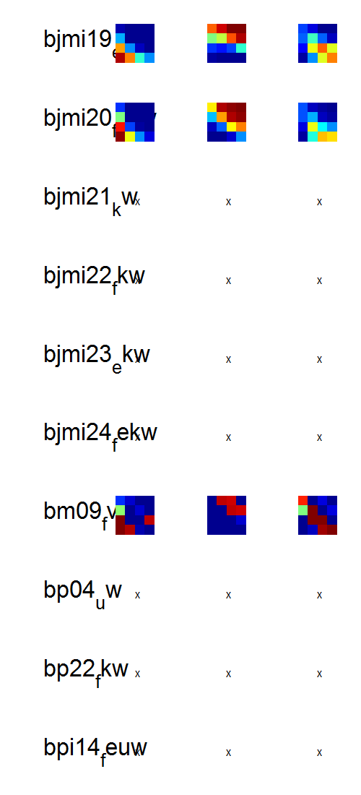
D:\Dropbox\SANDISK\8 Explore Mem\3b Modelling\1 Inputs\2b Hierar fits\New\res_hierarfitmodels_cF (16-Apr-2015) v1 remaining BICredone
Transform = +1;

Slide 17
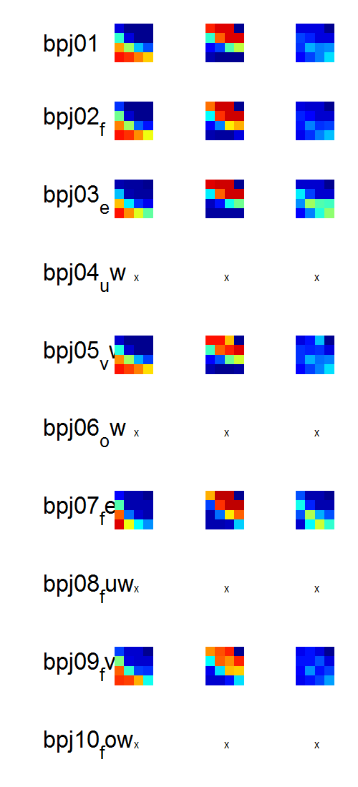
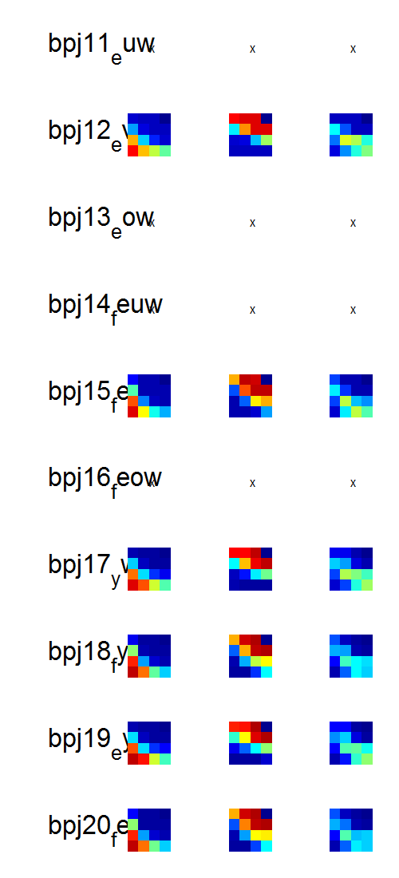
D:\Dropbox\SANDISK\8 Explore Mem\3b Modelling\1 Inputs\2b Hierar fits\New\res_hierarfitmodels_cF (16-Apr-2015) v1 remaining BICredone
Transform = +1;

Slide 18
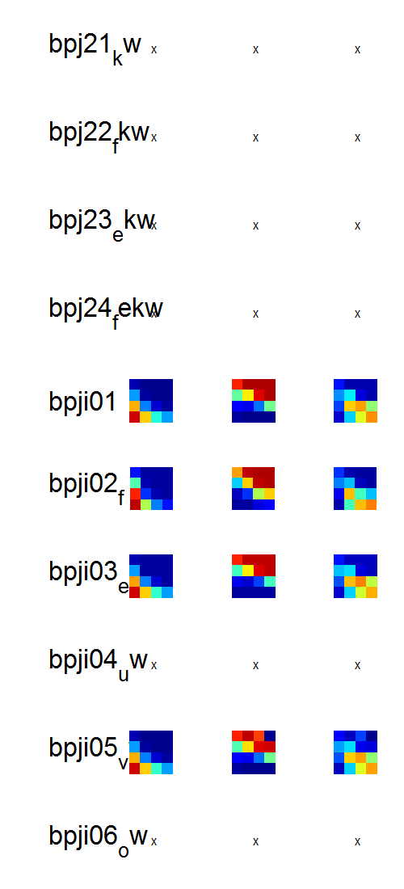
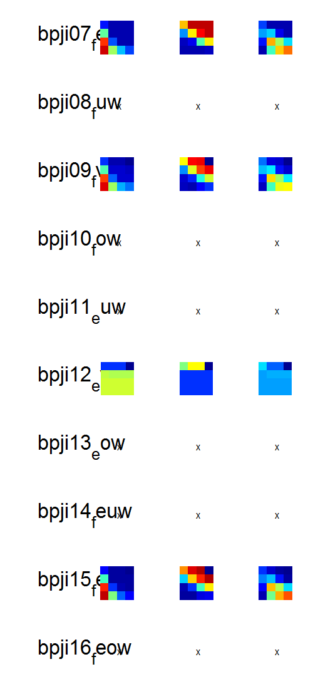
D:\Dropbox\SANDISK\8 Explore Mem\3b Modelling\1 Inputs\2b Hierar fits\New\res_hierarfitmodels_cF (16-Apr-2015) v1 remaining BICredone
Transform = +1;

Slide 19
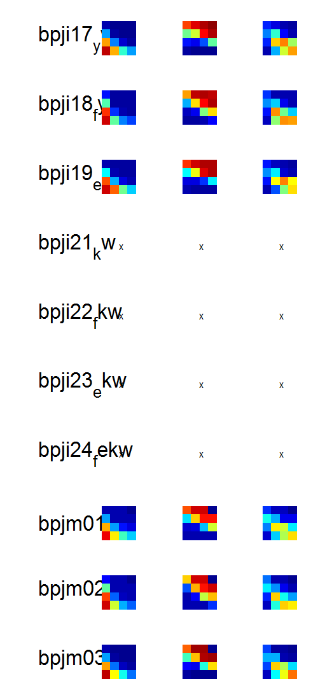
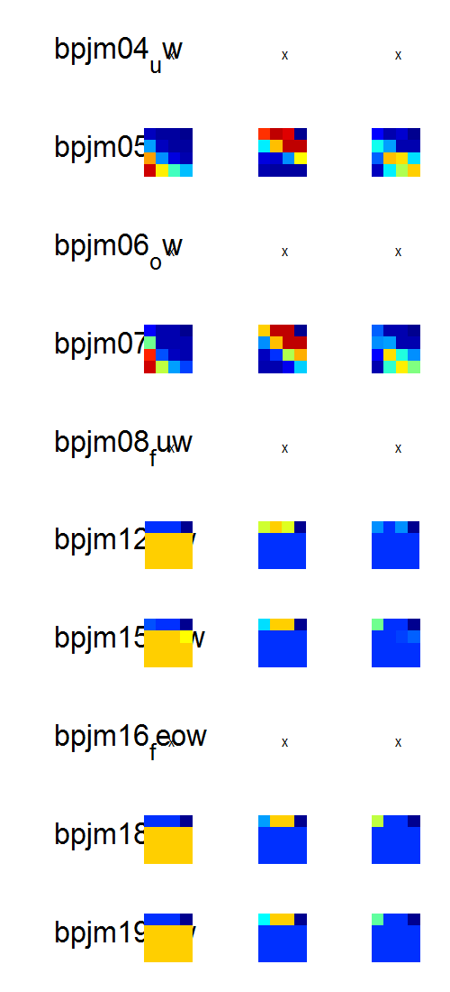
D:\Dropbox\SANDISK\8 Explore Mem\3b Modelling\1 Inputs\2b Hierar fits\New\res_hierarfitmodels_cF (16-Apr-2015) v1 remaining BICredone
Transform = +1;

Slide 20
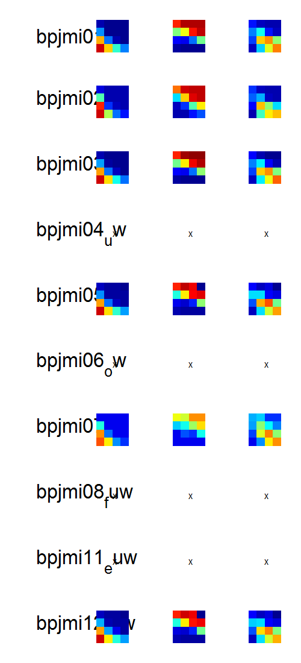
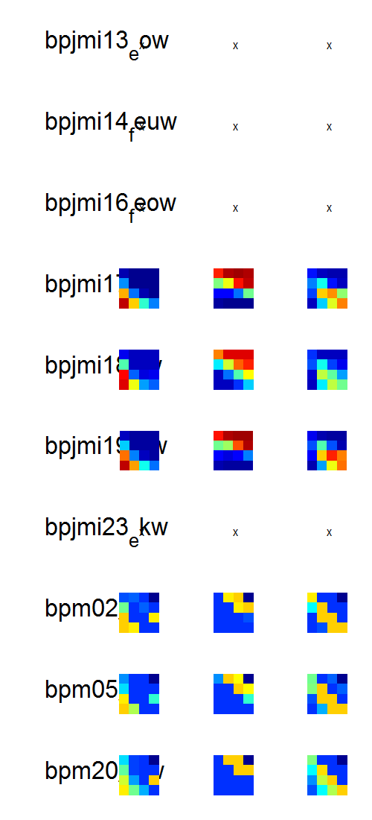
D:\Dropbox\SANDISK\8 Explore Mem\3b Modelling\1 Inputs\2b Hierar fits\New\res_hierarfitmodels_cF (16-Apr-2015) v1 remaining BICredone
Transform = +1;

Slide 21
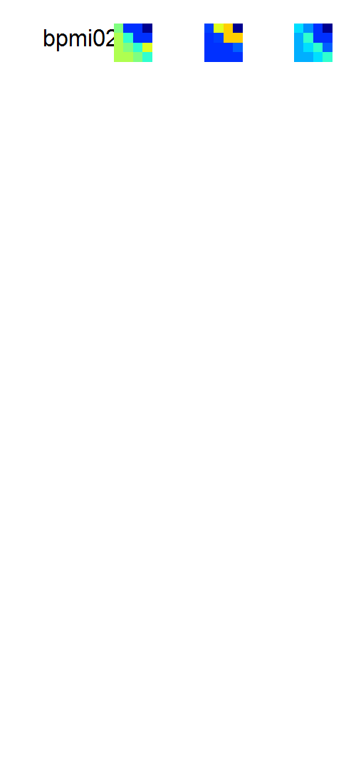
D:\Dropbox\SANDISK\8 Explore Mem\3b Modelling\1 Inputs\2b Hierar fits\New\res_hierarfitmodels_cF (16-Apr-2015) v1 remaining BICredone
Transform = +1;

Slide 22
D:\Dropbox\SANDISK\8 Explore Mem\3b Modelling\1 Inputs\2b Hierar fits\New\res_hierarfitmodels_cF (16-Apr-2015) v1 remaining BICredone
Transform = +1;

Slide 23
Slack v2

Slide 24
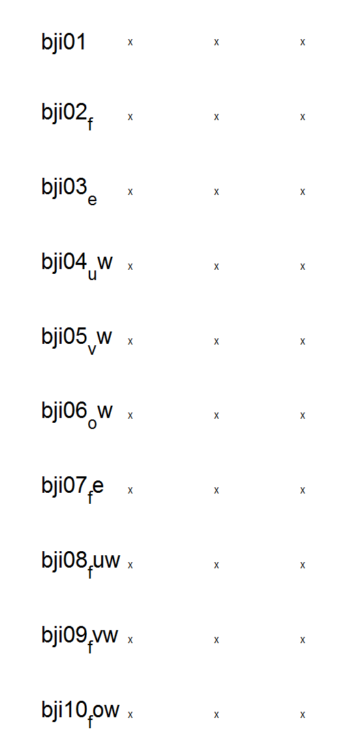
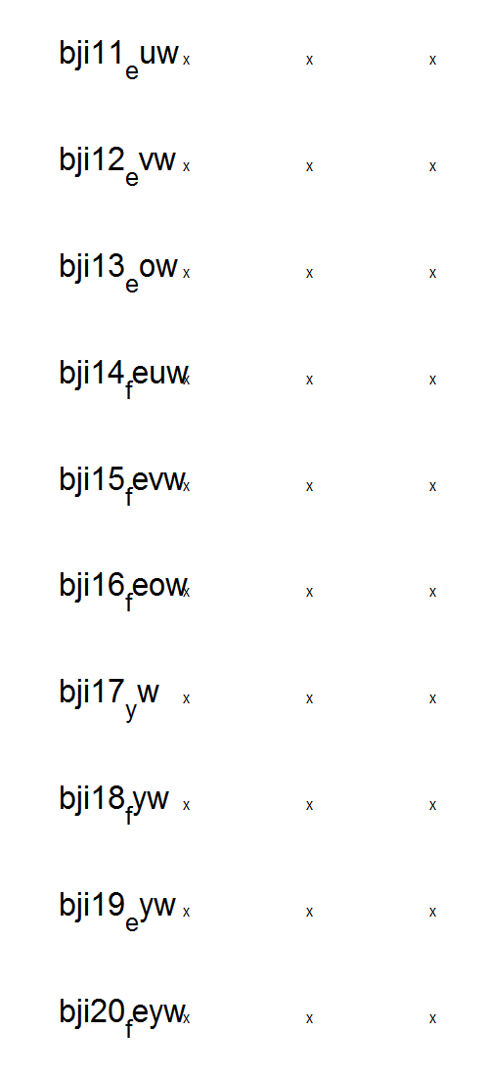
D:\Dropbox\SANDISK\8 Explore Mem\3b Modelling\1 Inputs\2b Hierar fits\New\res_hierarfitmodels_cF (16-Apr-2015) v2 remaining BICredone
Transform = 0

Slide 25
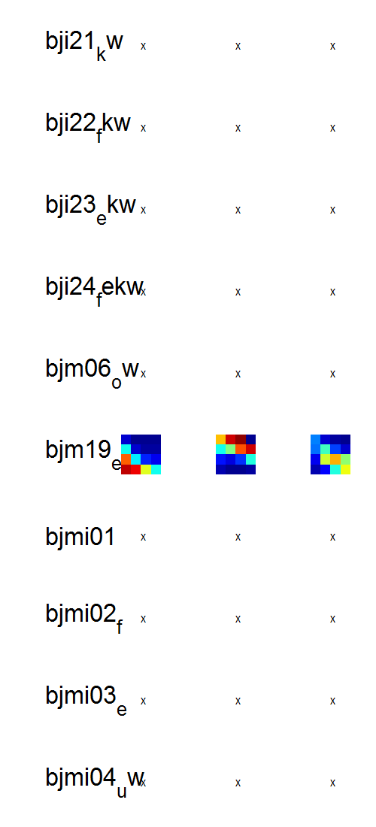
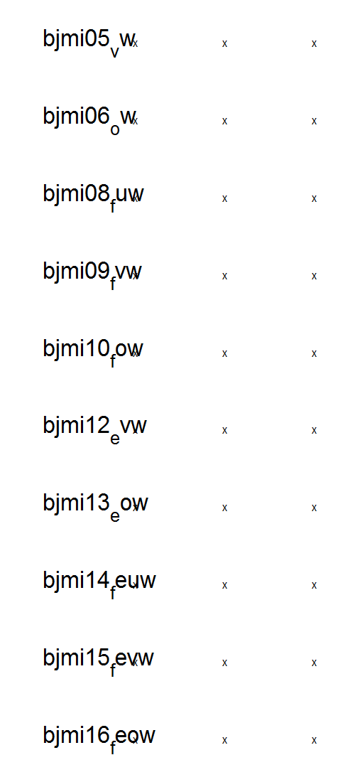
D:\Dropbox\SANDISK\8 Explore Mem\3b Modelling\1 Inputs\2b Hierar fits\New\res_hierarfitmodels_cF (16-Apr-2015) v2 remaining BICredone
Transform = 0

Slide 26
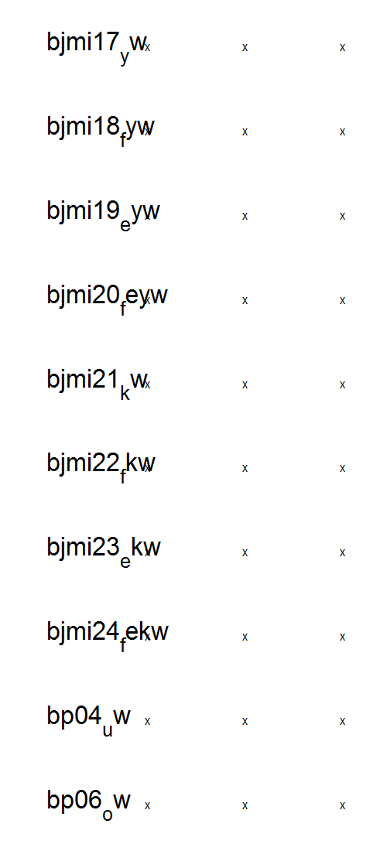
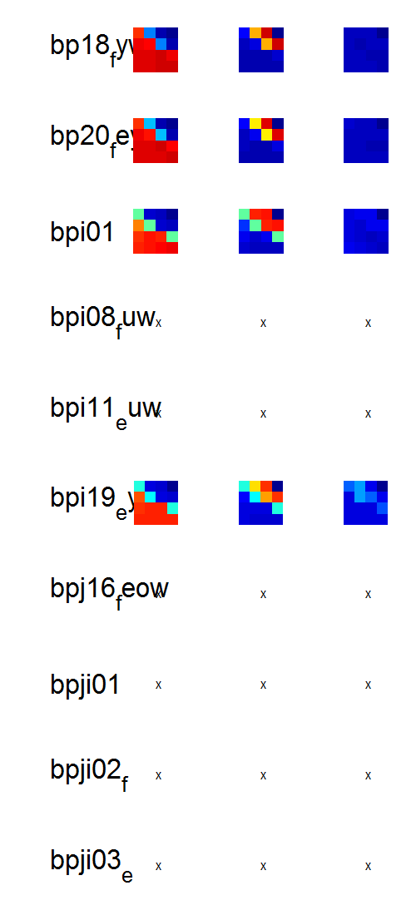
D:\Dropbox\SANDISK\8 Explore Mem\3b Modelling\1 Inputs\2b Hierar fits\New\res_hierarfitmodels_cF (16-Apr-2015) v2 remaining BICredone
Transform = 0

Slide 27
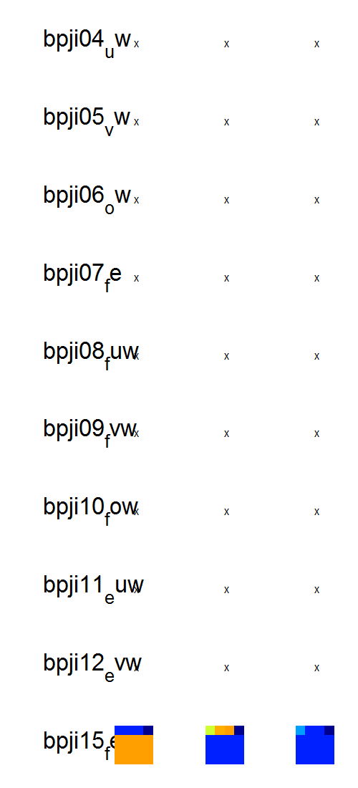
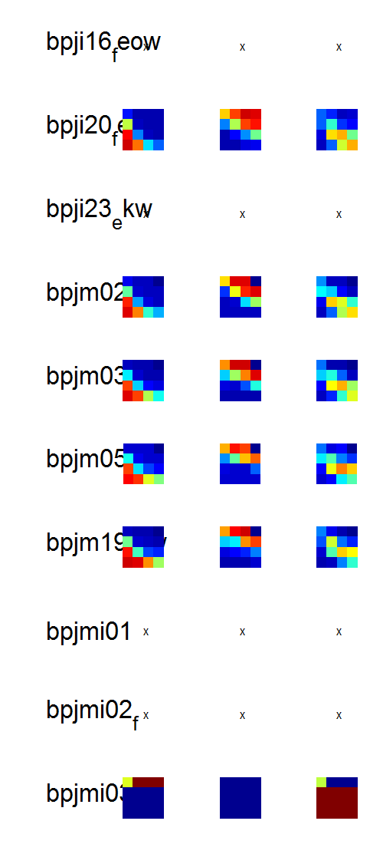
D:\Dropbox\SANDISK\8 Explore Mem\3b Modelling\1 Inputs\2b Hierar fits\New\res_hierarfitmodels_cF (16-Apr-2015) v2 remaining BICredone
Transform = 0

Slide 28
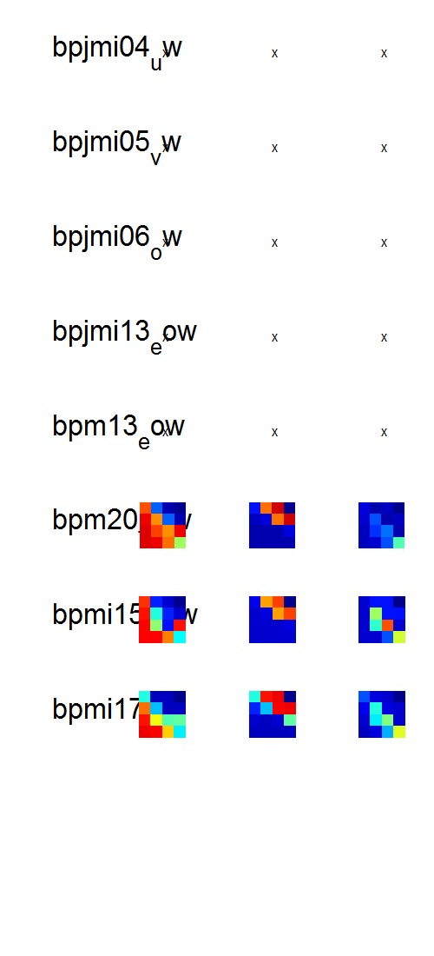
D:\Dropbox\SANDISK\8 Explore Mem\3b Modelling\1 Inputs\2b Hierar fits\New\res_hierarfitmodels_cF (16-Apr-2015) v2 remaining BICredone
Transform = 0

Slide 29
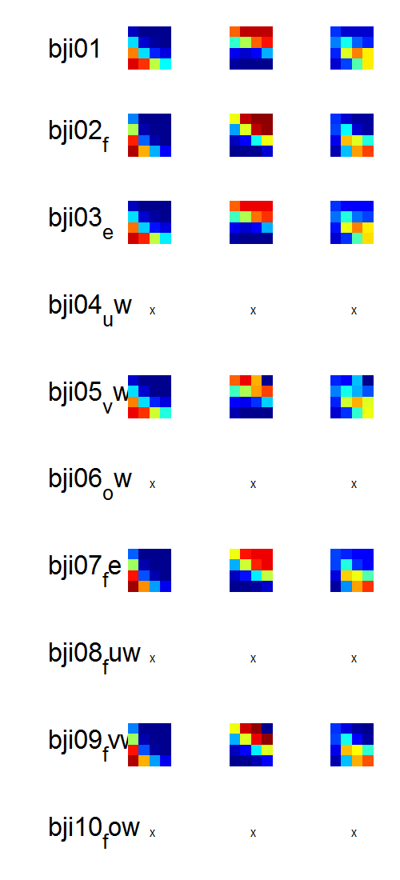
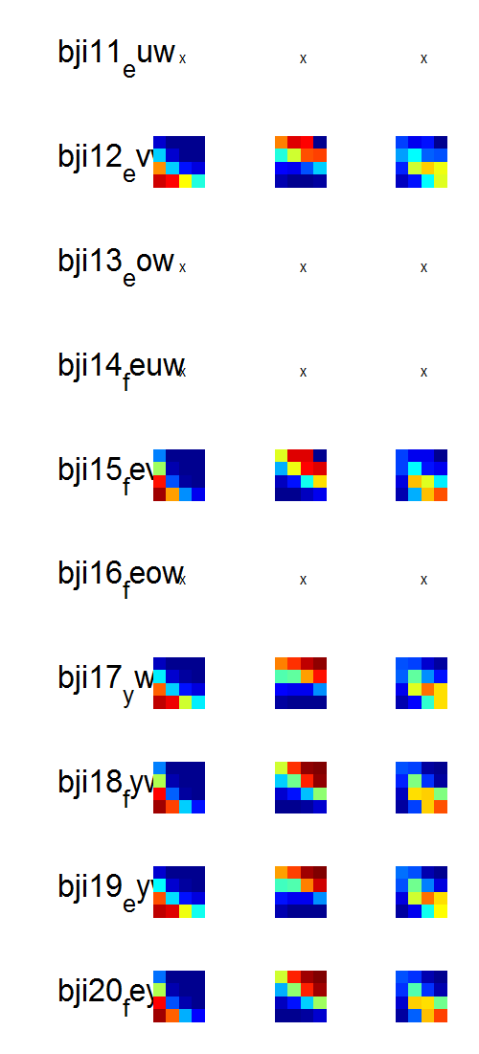
D:\Dropbox\SANDISK\8 Explore Mem\3b Modelling\1 Inputs\2b Hierar fits\New\res_hierarfitmodels_cF (16-Apr-2015) v2 remaining BICredone
Transform = +1;

Slide 30
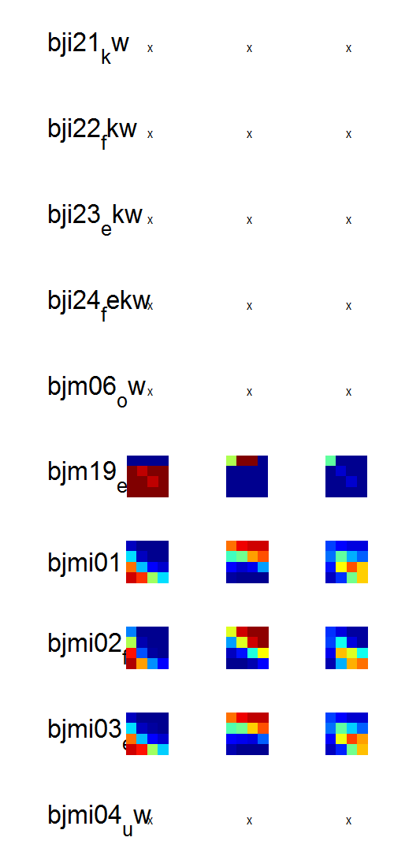

D:\Dropbox\SANDISK\8 Explore Mem\3b Modelling\1 Inputs\2b Hierar fits\New\res_hierarfitmodels_cF (16-Apr-2015) v2 remaining BICredone
Transform = +1;

Slide 31


D:\Dropbox\SANDISK\8 Explore Mem\3b Modelling\1 Inputs\2b Hierar fits\New\res_hierarfitmodels_cF (16-Apr-2015) v2 remaining BICredone
Transform = +1;

Slide 32


D:\Dropbox\SANDISK\8 Explore Mem\3b Modelling\1 Inputs\2b Hierar fits\New\res_hierarfitmodels_cF (16-Apr-2015) v2 remaining BICredone
Transform = +1;

Slide 33

D:\Dropbox\SANDISK\8 Explore Mem\3b Modelling\1 Inputs\2b Hierar fits\New\res_hierarfitmodels_cF (16-Apr-2015) v2 remaining BICredone
Transform = +1;

